Slide 1

Babysitting
Ms. Ericsson

Slide 2

Opening Activity
How many of you ever babysat before?
→ Let’s reflect on babysitting:

Slide 3
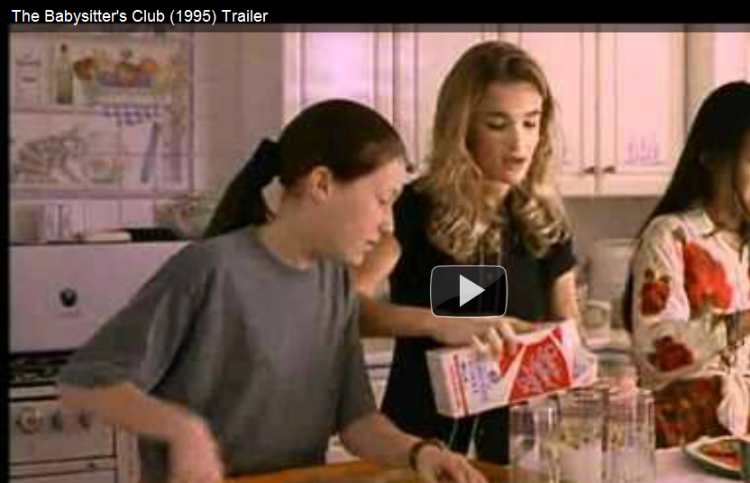
Opening Activity

Slide 4


Opening Activity
Are you ready to be a babysitter?
  Survey
  According to The Doctors

Slide 5
Dr. Jim Sears’ Babysitting Readiness Quiz:
Are you ready to be a babysitter?
1. Around younger children, which do you tend to do:
A. Tease the younger kids
B. Observe the younger kids
C. Attempt to teach or engage younger kids
2. If you were alone with a younger sibling for an entire day:
A. You have to admit, you’re scared to think about what might go on.
B. You think you’d PROBABLY be okay, but are pretty sure there would be some rules broken.
C. You are almost sure you would be absolutely fine.
3. In situations where young children are present, you tend to:
A. Avoid them most of the time, trying to be alone or with older people
B. Spend SOME time with them, but loses interest over time
C. Spends almost every minute with them

Slide 6
4. If given the choice, you would rather:
A. Play with a video game
B. Play with a pet or kids his or her own age
C. Play with younger siblings, family members or friends
5. Alone in an emergency, you would be more likely to:
A. Panic and become hysterical, upsetting everyone around
B. Become anxious, but not fall apart
C. Remember what to do in the moment, even if you fell apart later on
6. When asked to do household chores, you:
A. Are most likely to blow them off
B. Will put them off, and will only do them after much poking and prodding from your parents
C. Do them eagerly and regularly, rarely having to be reminded

Slide 7
7. Teachers and friends would most likely describe you as:
A. A handful! Outspoken with a precocious streak
B. A good kid, but sometimes absentminded
C. Responsible and reliable
8. You and younger sibling tend to fight:
A. Daily ‐ about anything and everything!
B. Occasionally ‐ about things that matter
C. Almost never ‐ we get along very well
9. After a fight with siblings, you:
A. Complains and sulks until your parent steps in
B. Show you upset, but can usually let it go in about a day or so
C. Apologizes and moves on
10. In school, you:
A. Get reprimanded by the teacher fairly frequently for breaking the rules
B. Are typically in line with the exception of talking in class or other minor infractions
C. Usually follow the rules to at all times

Slide 8
Opening Activity
SCORING:
A answers = 0 points
B answers = 1 points
C answers = 2 points

Slide 9
Opening Activity
What your total means:
0‐6 You are probably not yet emotionally mature enough for babysitting. Hold off on caregiving responsibilities until you begin to gain/show more interest and exhibits more responsibility at school and at home.

Slide 10

Opening Activity
What your total means:
7‐14 You may be partially ready, but most likely needs more time to mature and learn. Work on the areas that need improvement and most likely you will get there in no time! Reevaluate in six months.

Slide 11
Opening Activity
What your total means:
15‐20 Congratulations, you are ready to spread babysitting wings! Try a practice run for one or two hours at a time to evaluate your performance, and continue with longer stretches as abilities are proven. Make sure to get feedback from the children being cared for: Did they enjoy their time? Did everything go OK while the adults were away? If you are at this stage, classes in CPR and first aid will enhance his or her qualifications to become a successful babysitter.

Slide 12
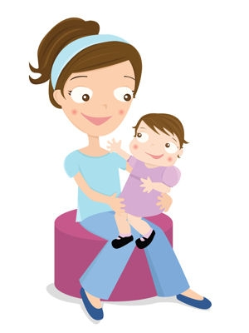
Babysitting
DEFINITION
Caring for children for a short time while parents are away from the home
The most common first
child care job

Slide 13

Making Arrangements
Questions to ask:
  Rate of pay
  Time frame
  Transportation
  Name (parents & children), address, and phone number

Slide 14
Making Arrangements
Arrival:
  20 minutes early
    Meet children
    Additional information
    Ask questions
      Bedtimes
      How to reach parents
      Emergency procedures
      Special considerations

Slide 15
Important Qualities
Interested in children
  Not just for the money
Behave responsibly
Patience
Understand development
Flexible
Prepared
Sense of humor

Slide 16
Caring for Different Ages
Babies
  A lot of physical care and protection
  Diaper change
  Rules:
    Hold firmly, support head and neck
    Never leave unattended
    Keep harmful object out of reach
    Never shake
    Positive, loving interaction

Slide 17
Caring for Different Ages
Toddlers and Preschoolers
  Never leave alone
  Comfort
  Read, play with, talk to
  Follow regular scheduled bedtime

Slide 18
Caring for Different Ages
School-Age Children
  Make friends
  Show interest
  Read, play with, talk to
  Be firm, but fair and consistent
  Never use physical punishment

Slide 19
Parents
Parents should make it clear to their children that a babysitter has authority
  Right to make decisions

Slide 20
Activities
Be an entertainer, not a best friend
Ideas for activities:
  Music
  Board games
  Hide and seek
  I spy
  Hop scotch
  Paint projects
  Puzzles
  Make snacks
  Clay
  Play dough

Slide 21
Safety Tips
Requires your full attention

Slide 22
Safety Tips
Household Tips:
  Appliances
  Windows, doors, lights, and alarms
  Smoke detectors
  Outside the house

Slide 23
Safety Tips
The Child’s Safety
  Food
  Water
  Falls
  Poisons and sharp objects
  Burns/scalds
  Choking
  Strangulation

Slide 24
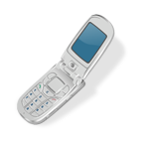
Safety Tips
Your Own Safety
  The door
  The phone
  Your parents
  Transportation
  Trust your gut

Slide 25
Emergencies
Stay CALM!
Emergency numbers
Emergency supplies
Emergency escape routes

Slide 26

How to Satisfy Parents
Children are well cared for, safe, and happy
Arrive on time
Follow all routines/directions
Straighten up
Show interest and interact

Slide 27
At your table, discuss the following questions and write the answers on the paper provided.
1. WHAT ARE THREE THINGS YOU SHOULD DO BEFORE ACTUALLY BABYSITTING?
2. What are at least three qualities a caregiver should have?
3. Nave two things you should do when caring for each of the following age groups?
Babies?
Toddlers and Preschoolers?
School aged children?
4. Name at least three ways you can entertain children while babysitting?
5. What are three things you can do to ensure the safety of the children?
Review

Slide 28
Image Credit
http://thepolkadottot.com/weblinks.htm
http://christianbabysitter.homestead.com/buynow.html
http://www.mominmanagement.com/1390/babysitter-rate-calculator/

Slide 29
Sources
Babysitter Tips. Babysitters, n.d. Web. 11 Apr. 2011. http://www.babysitters.com/babysitter-tips-2/
Babysitter Information. Baby Center, n.d. Web. 11 Apr. 2011. http://www.babycenter.com/babysitters
Brisbane, Holly E. The Developing Child. 8thth ed. Peoria: Glencoe/McGraw-Hill, 2000. 306-11. Print.

Slide 30
Sources
It's My Life. Money. Babysitting. One Important Job!. PBS, n.d. Web. 11 Apr. 2011. http://pbskids.org/itsmylife/money/babysitting/index.html
Teen Health. Nemours, n.d. Web. 11 Apr. 2011. http://kidshealth.org/teen/school_jobs/jobs/babysit.html#

